Slide 1
Network Topologies
Jared DeWinne
Professor Adams
October 2018

Slide 2
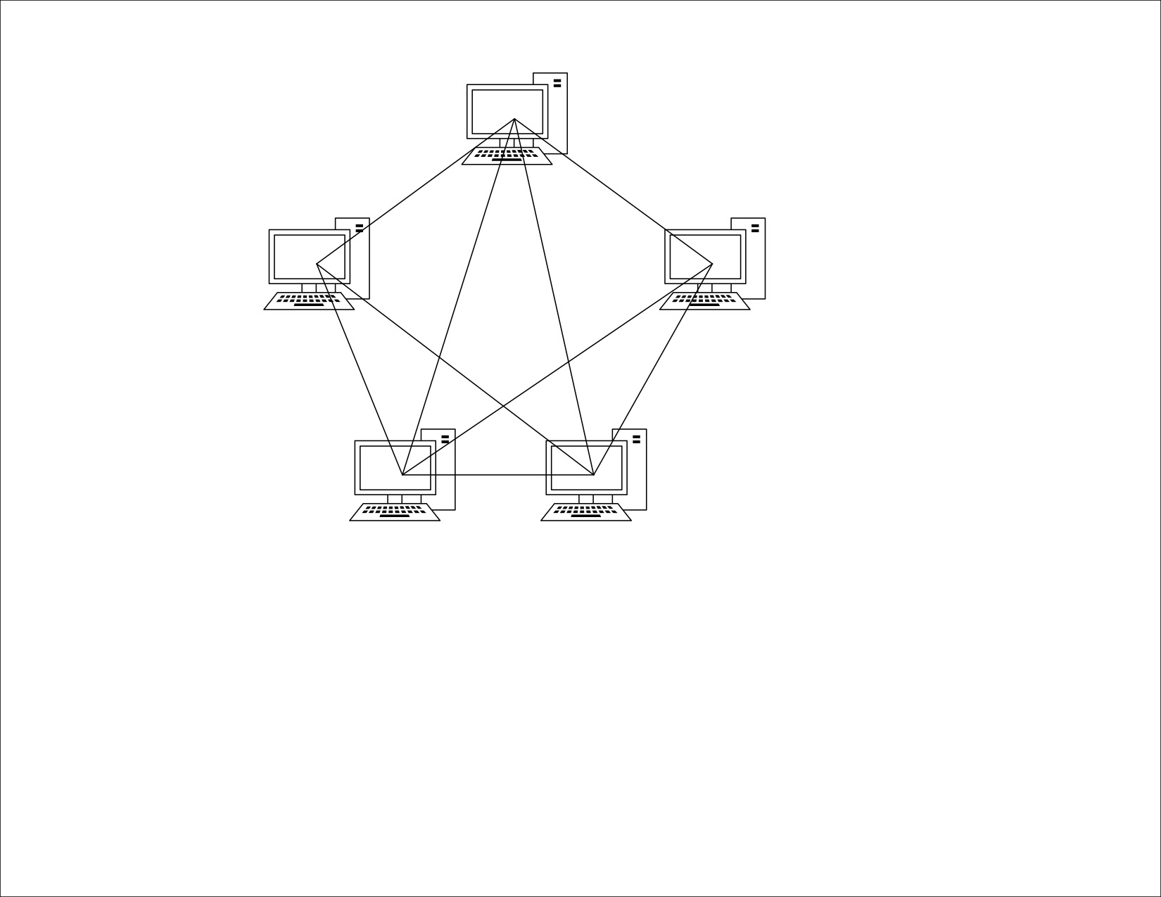
Mesh Network
Notes:
In this network, every individual devices has a point to point link to every other device.
Adv:
Each link carries it’s own load, which avoids traffic problems
Robust, if one link gets damaged, the others don’t.
Privacy and security as data travels along a dedicated link
Fault identification and fault isolation is easy
Disadvantages:
Amount of cabling is large
Bulk of wiring is larger than available space
Expensive hardware
Digital traffic travels in each own dedicated line, which in the future could take cellular traffic off the grid.

Slide 3
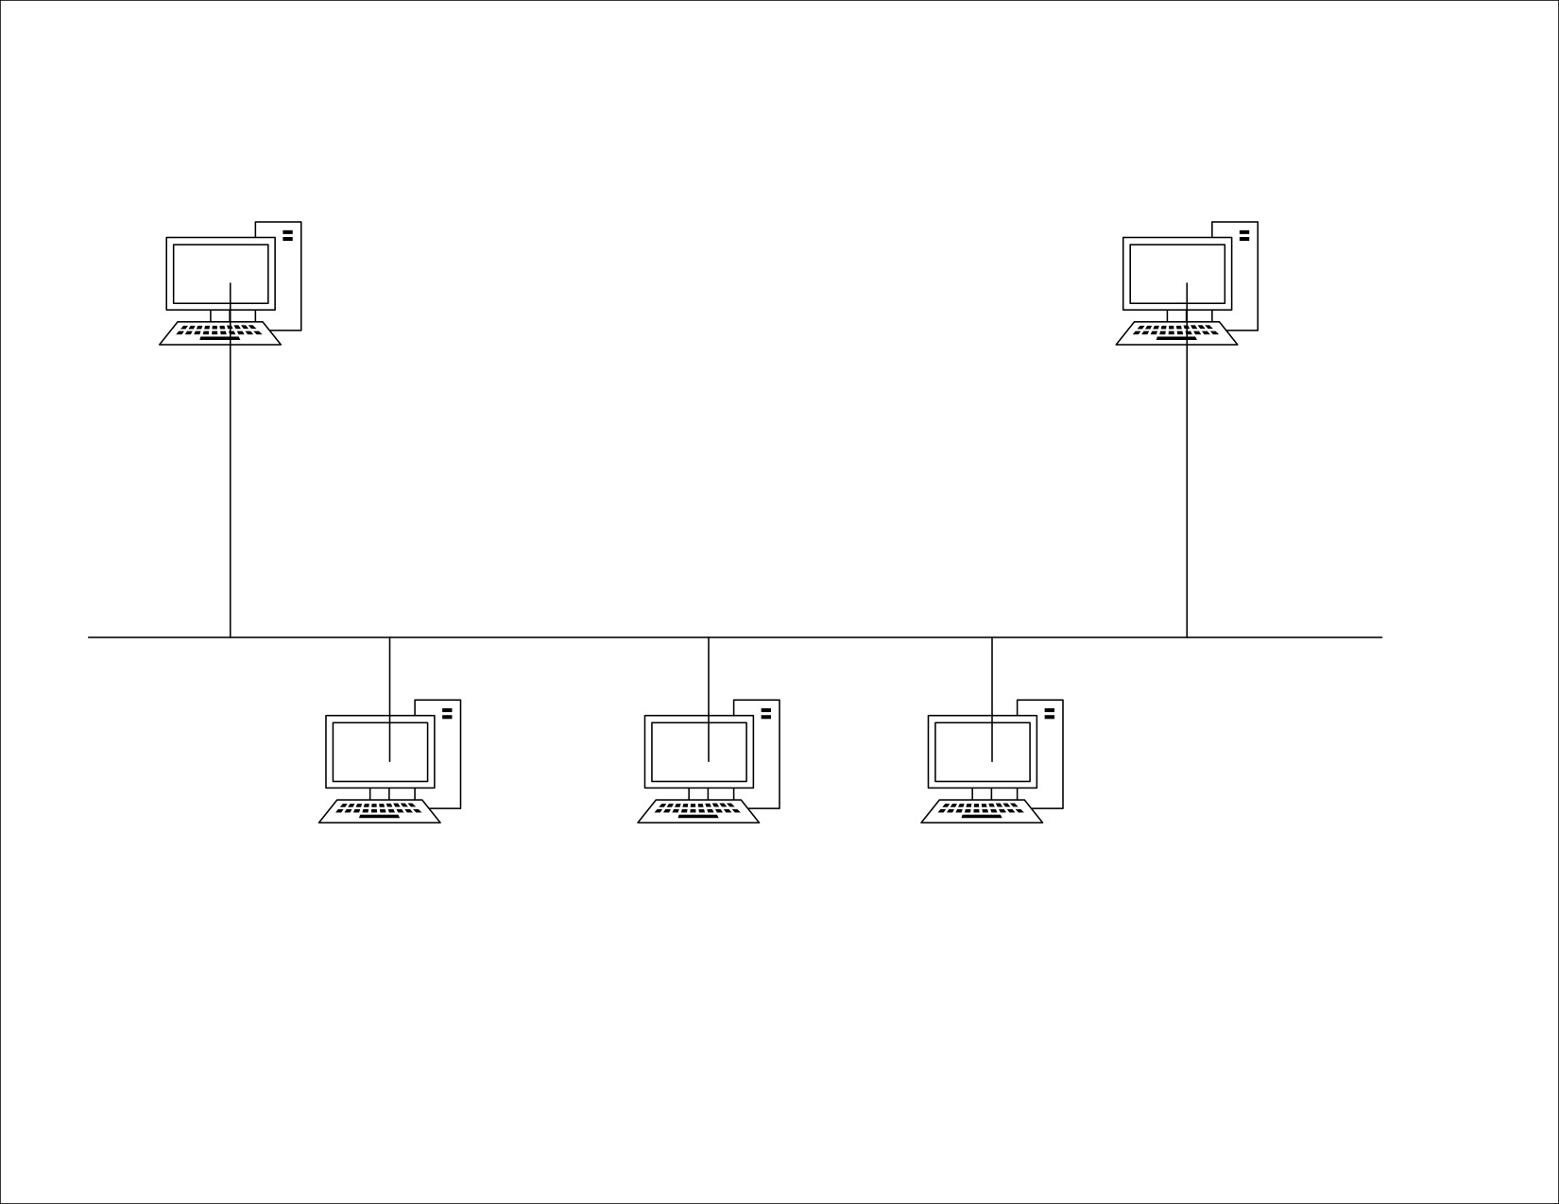
Bus Network
Notes:
Multipoint
One long cable acts as a backbone to link all the devices, which are connected via drop lines and taps.
Drop line is the connection between the devices and cable
Tap is the splitter that cuts the main link
This allows for only one device to transmit at a time
Advantages:
Easy installation
Less Cabling
Disadvantages
Difficult reconfiguration
Difficult fault isolation
Difficult to add new devices
Signal reflection at the top can degrade quality for the whole network
Any fault in the backbone can stop all transmission.
A device wants to communicate with another so it sends a broadcast message onto the wire and all other devices see but only the intended device accepts and processes the message.

Slide 4
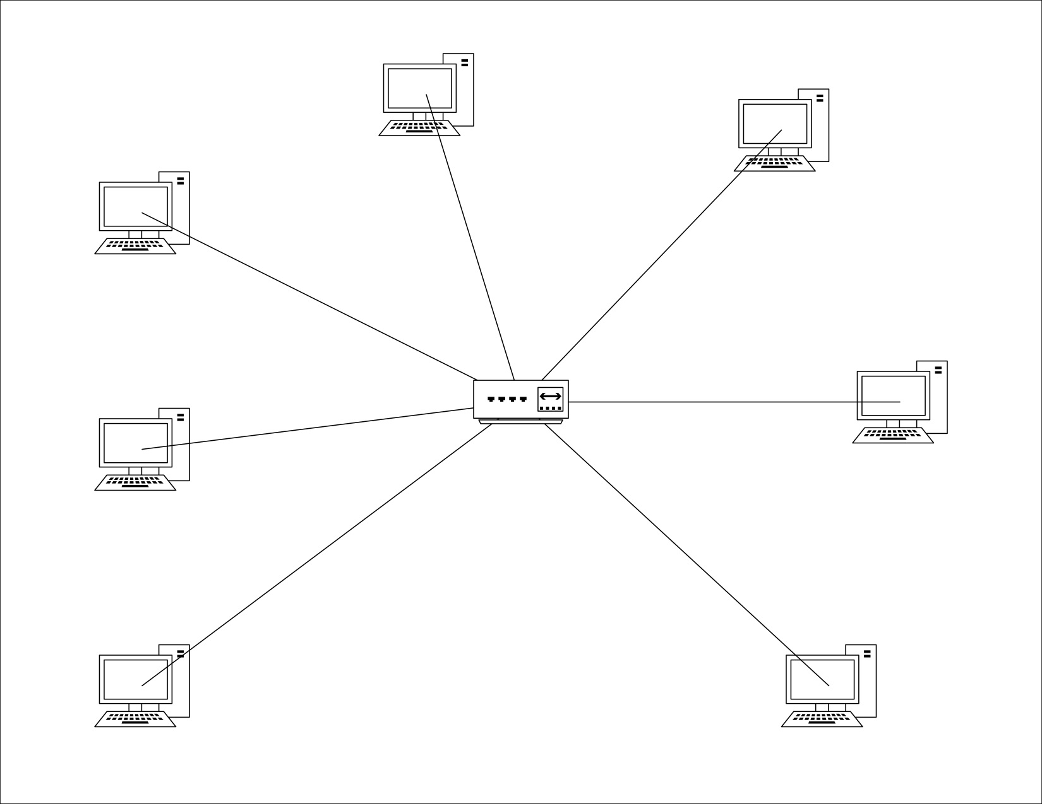
Star Network
Notes:
In a Star network each device has its own dedicated point-point link to the Hub.
There is no direct traffic between devices.
Transmission only occurs through the hub
Advantages:
Cheap
Installation and configuration is easy
Less cabling required
Robust
Easy to identify fault and remove faulty parts
No disruptions to network
Disadvantages:
Even though its less cabling, when compared to other topologies, it is rather large
Dependency, when Hub goes down, all goes down.
When device #1 wants to send data to device #2 first sends data to hub which then relays the data to the other device.

Slide 5
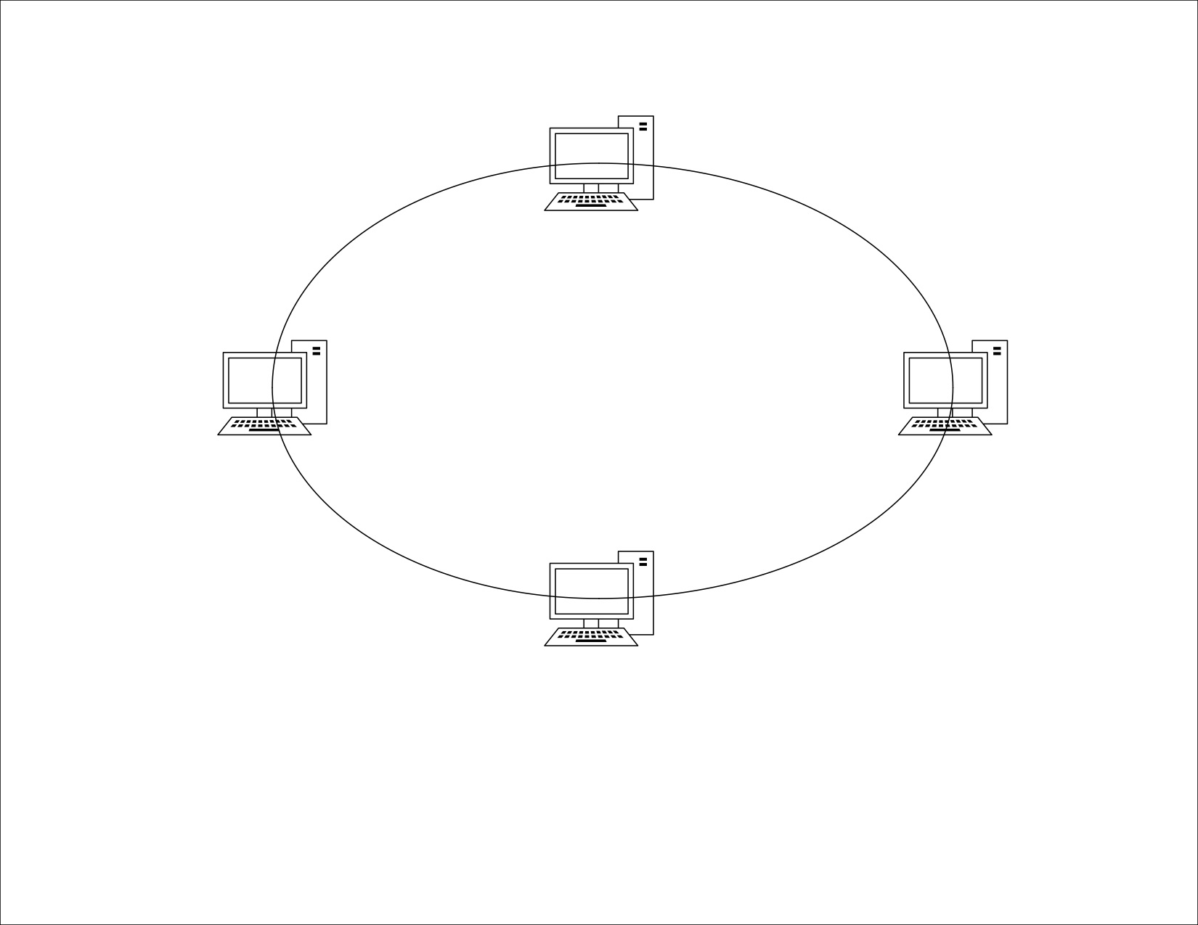
Ring Network
Notes:
Each device has its own dedication with two devices on either side
Signal is passed in one direction from device to device to device until it reaches the destination and each device has a repeater
When one device received signals intended to another device, its repeater regenerates the data and passes it along
To add or delete devices, this requires only changing two connections
Advantages:
Easy to install
Easy to reconfigure
Fault identification is easy
Disadvantages:
Unidirectional traffic
A break in a single ring can break the entire network
Connection useful in old settings such as some office buildings or school campuses.

Slide 6
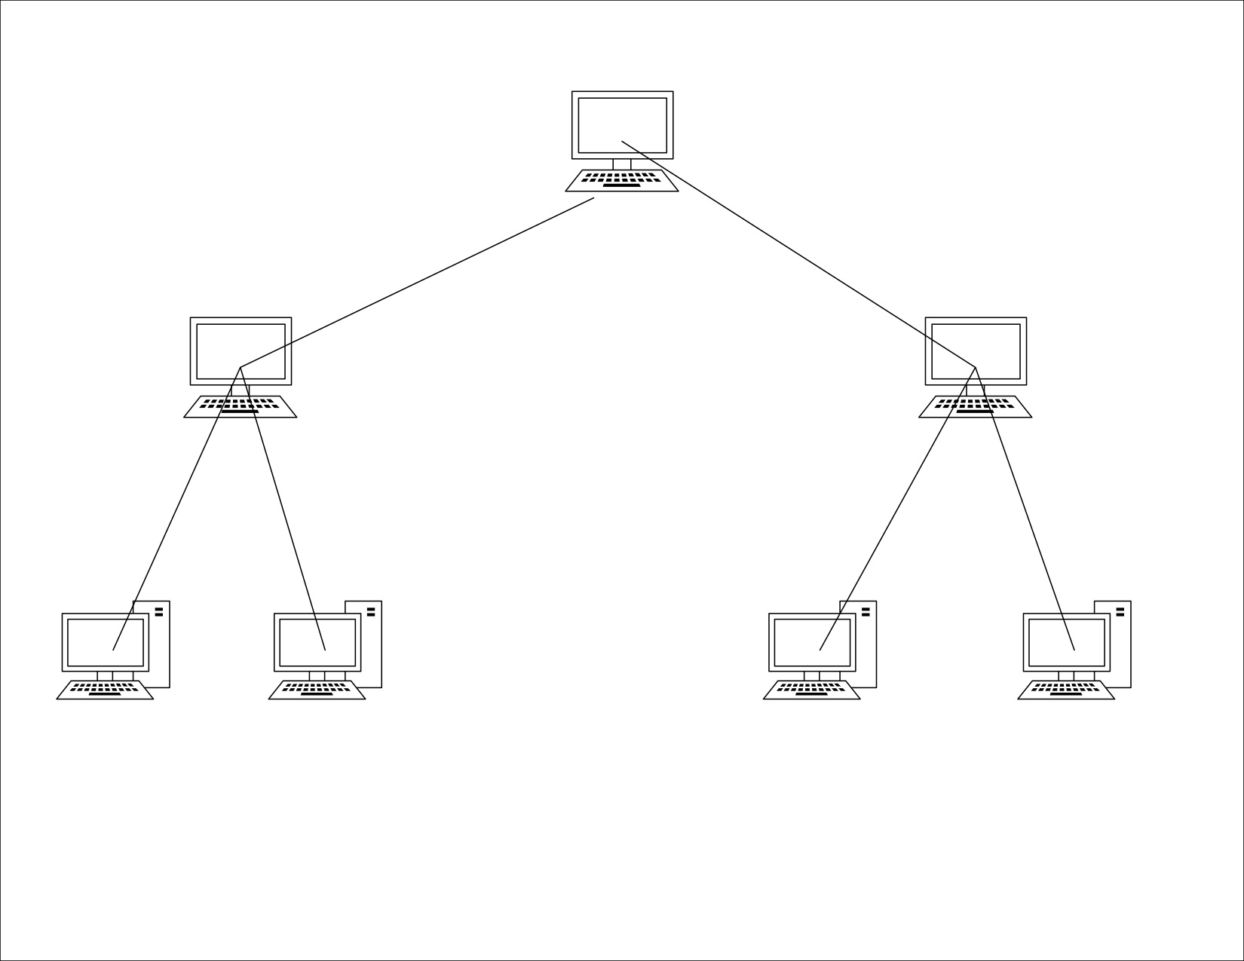
Tree Network
Notes:
Also called a star bus topology
Most common setup similar to a bus topology and a star topology
Connects multiple star networks to other star networks
Advantages:
Scalable
Easy maintenance and fault finding
Other hierarchical networks are not affected if one gets damaged.
Disadvantages
Huge cabling is needed
Lot of maintenance is needed
Backbone forms the main point of failure
There exists a root note, intermediate parent node, and leaf nodes where this hierarchy is used.

